Slide 1
Object Oriented Programming Lab CSE 1206
Lab 4

Slide 2
Method Overloading
Java allows different methods to have same name.
Conditions:
By changing number of arguments.
By changing the data type of arguments.
Now Create a new Project Named MethodOverloading.
Inside this Project Create a new Class Named Adder.

Slide 3
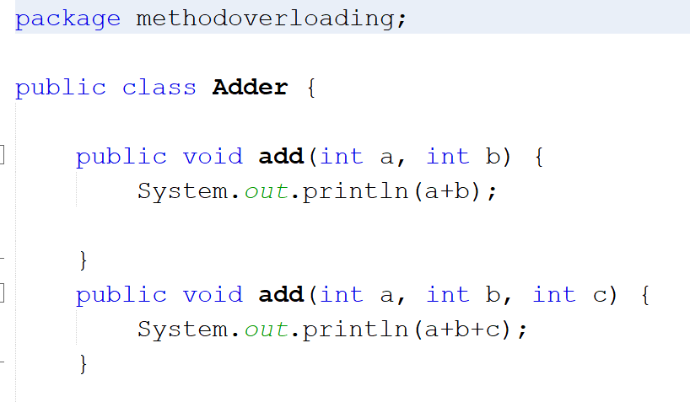
Two methods having same name add but number of arguments in the parameter are different

Slide 4
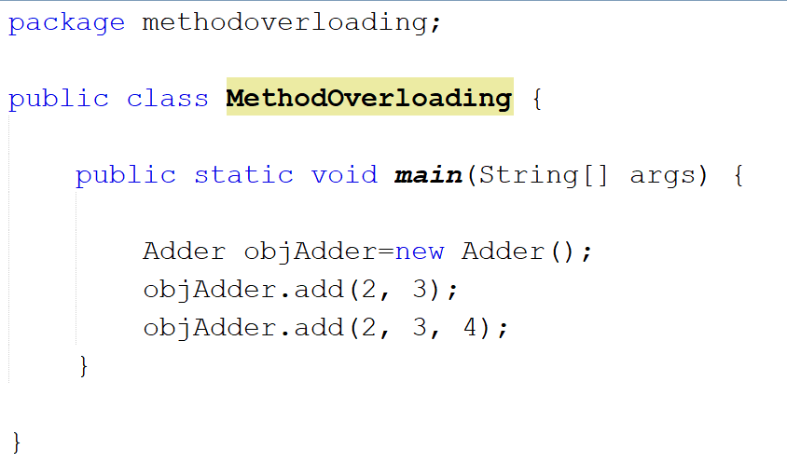

Slide 5
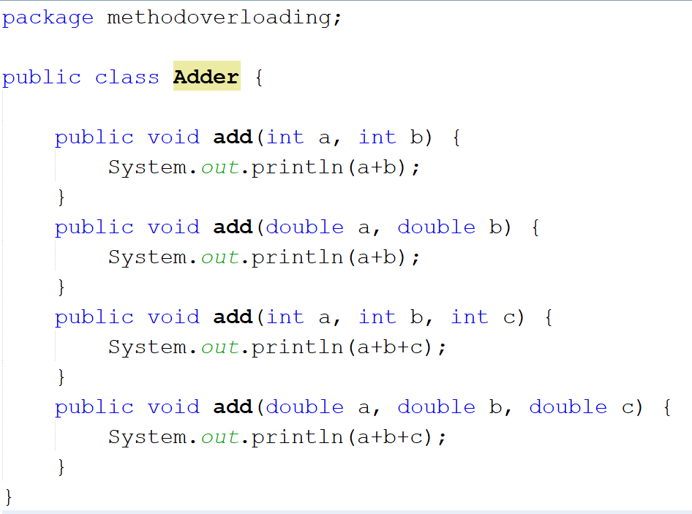
Methods having same name add and same number of arguments but type is different

Slide 6
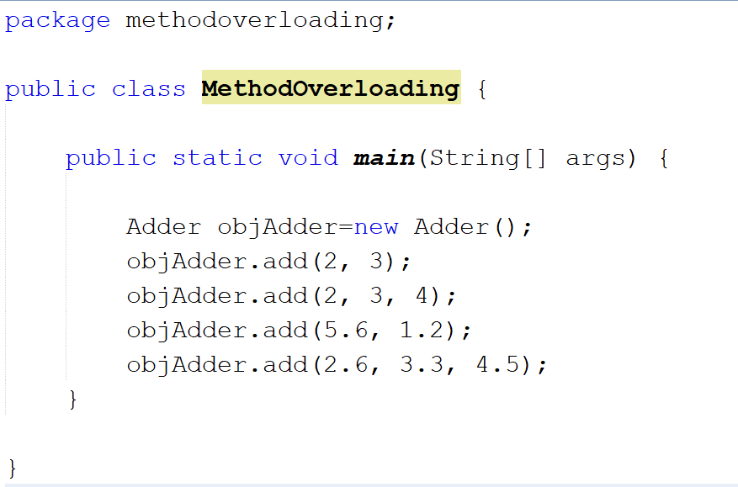

Slide 7
Changing the return type is not counted as method overloading

